Slide 1
!
List Of Figure & Tables In The Dissertation
?
!
!

Slide 2
!
List Of Table And List Of Figures
The list of figures and tables are most important in the dissertation.
They specifically sound like where lists of all tables and figures used in the dissertation are in coherence with the pages of numbers.
The list of tables and figures in the dissertation is like the table of contact that helps to reach the specific table and figure with the help of page numbers.
Hence in all this, the corresponding page numbers are most important followed by the clear titles and usage of numbers in the text.
?
!
!

Slide 3
!
Use Numbers And Clear Titles In The Text
These lists offer the readers a detailed overview.
How one has used these related items in the dissertation and support them to find the specific tables and figures of interest.
Often, such lists are not much required in the dissertation it is mainly recommended when a researcher is using several figures and tables or the dissertation is large in terms of pages.
Thus, the tables and figures always require to be clear titled with proper numbering.
In Microsoft word to add the titles and numbers and highlight the tables and figures by selecting the insert caption from right-click option.
?
!
!

Slide 4
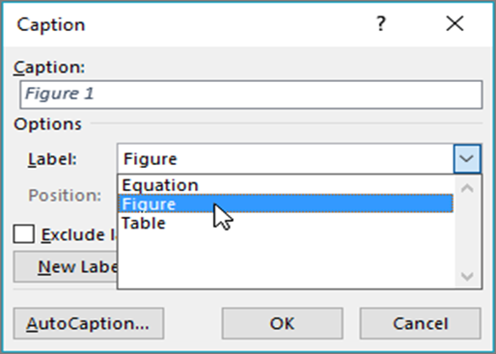
!
Use Numbers And Clear Titles In The Text
?
This is Dialogue Box
for Caption in Microsoft
Office through which
the list of table and
figures are generated.
!
!

Slide 5
!
Generate Lists Automatically
Automatically, the list of tables and figures will depict all the graphics and tables in the document.
Where each entry is further supported by title, number and specifies the page number which is most important for the navigation.
The listing is continuous in the proper sequence, where no number on the page with the main headings may be used.
Firstly researcher has to add captions to the related figures.
The insertion of a table of figures command is used through the reference tab
?
!
!

Slide 6
!
Steps To Generate Lists Automatically
?
Steps 1
The placement of cursor where the researcher has wanted to originate the list.
Where the most common and appropriate place for this list is after the table of contents.
!
!

Slide 7
!
Steps To Generate Lists Automatically
Step 2
The second step comprises that in the menu bar of a word the click on references is most important.
The dialogue box has appeared to click the insert option for a table of figures.
From the dialogue box, there is an option for the selection of table or figure and also an option for layouts that can be used within the requirements.
?
!
!

Slide 8
!
Representation Of List Of Tables And Figures In Microsoft Office
?
!
!

Slide 9
!
Representation Of List Of Tables And Figures In Microsoft Office
?
!
!

Slide 10
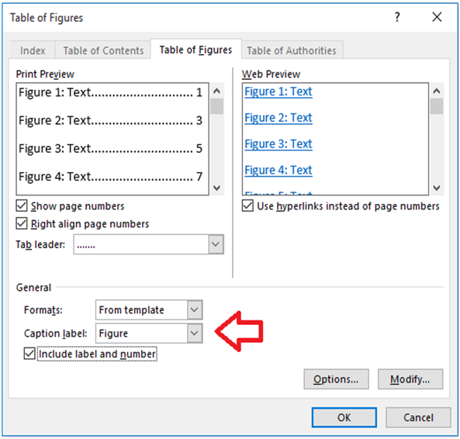
!
Dialogue Box For Table Of Figures In Microsoft Word
?
!
!

Slide 11
!
Checklist For List Of Tables
All number of pages should be appropriately aligned that are mentioned in the list of tables and page number.
Where between these places the similarity is most important that helps to navigate the data of dissertation.
The table of content should be updated at all times.
It should be properly formatted in consideration of the provided guidelines.
All titles of tables match what exactly appears in the text mentioned while captioning the table.
All the tables should be listed in the tables of the document except those specific tables listed in the appendices.
?
!
!

Slide 12
!
Checklist For List Of Tables
The Source of each table is equally important which is also mentioned in the bibliography in the end.
The template instructions should be followed which defines the writing styles, alignment, margins, font and formatting of the title which support to standardise the dissertation.
The style of the words or format should be set to the visual style gallery.
After insertion of the list of tables and figures and when finished, the page break is most important.
So that the first chapter of a dissertation should be started from a separate and new page and not mixed with the list of tables or figures.
?
!
!

Slide 13
!
?
GOOD LUCK
!
!

