Slide 1






!
Research
Questions
?
!
!

Slide 2
!
What Is A Research Question?
In a dissertation, the research question revolves around your research to deliver you clear purpose and focus. Research questions need to be;
Concise
Complex
Arguable
Relevant
Focused
Researchable
Specific
?
!
!

Slide 3
!
Why Research Question Are Important?
?
Research questions helps you to put attention to your research through enabling a route towards the research and process of writing.
A well-established research question will help you to work to supporting a certain, debatable dissertation.
!
!

Slide 4
!
Types Of Research Question?
?
There are many types of research questions that can be categorised into different types, depending on the research nature.
This depends either your research is qualitative, quantitative, or mixed-method.
!
!

Slide 5
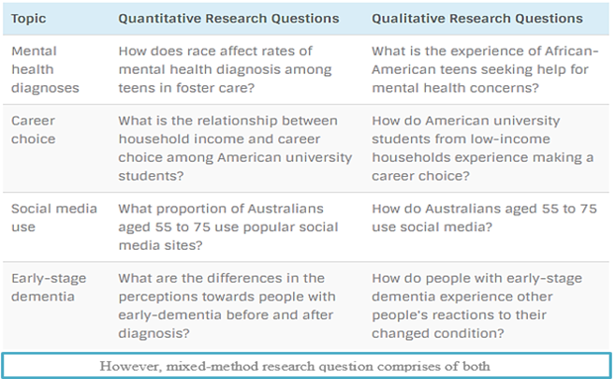
!
Types Of Research Question?
?
!
!

Slide 6
!
How to write Research Question?
?
Select a comprehensive topic
Do introductory reading to discover about current arguments and problems
Narrow down certain position that you require to pay attention to
Classify a theoretical/practical research problem that you will discourse
!
!

Slide 7
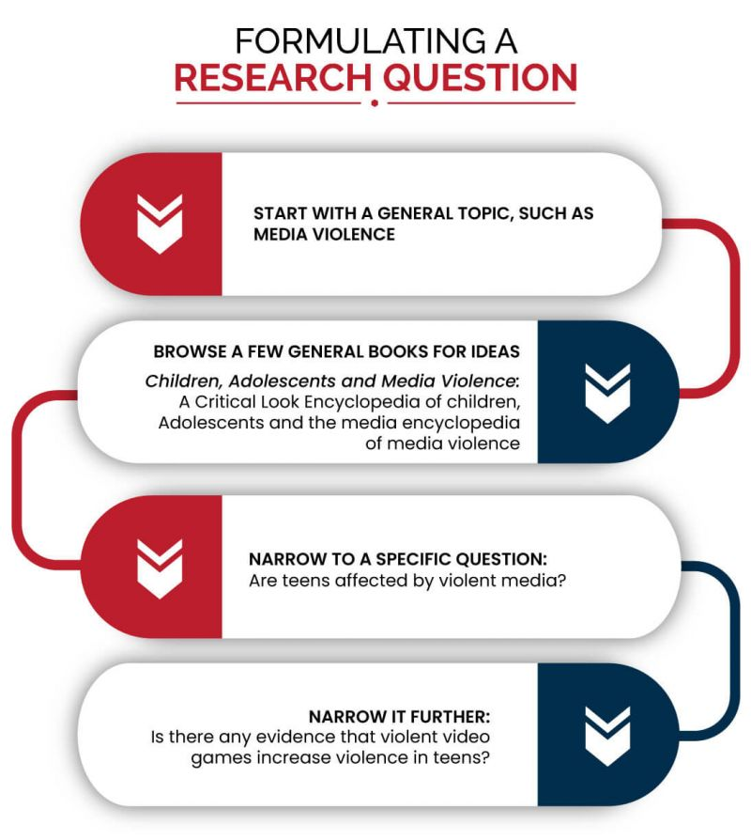
!
?
!
!

Slide 8
!
?
GOOD LUCK
!
!

