Slide 1






!
Dissertation
Chapter One –
Introduction
?
!
!

Slide 2
!
What Is Dissertation Introduction?
?
The first chapter of any dissertation is the ‘Introduction’.
It introduces the reader to your dissertation in order to comprehend what you are trying to answer or the issue you are trying to resolve.
!
!

Slide 3
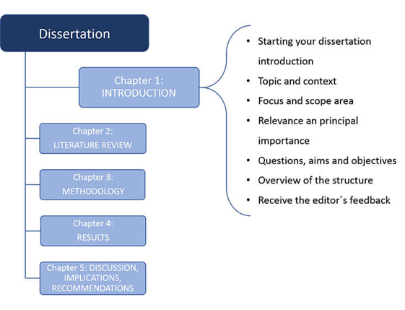
!
What Is Dissertation Introduction?
?
!
!

Slide 4
!
What Is Dissertation Introduction?
Why Introduction is Mandatory for Dissertation?
Introduction is very important for any research as it ensures the following things;
It initially enables the reader of the background information which puts in the context of your dissertation.
It illuminates your dissertation’s focus.
It demonstrates your dissertation’s value.
It determines your dissertation’s aim and objectives.
?
!
!

Slide 5
!
How to Write a Dissertation Introduction?
It is important to draw attention of the reader to your dissertation.
It is necessary for you to provide the reader with clear direction, purpose, and focus. Hence, the introduction must include;
Topic and context - Questions and objectives
Focus and scope - Overview of the structure
Relevance and importance
Questions and objectives
Relevance and importance
?
!
!

Slide 6
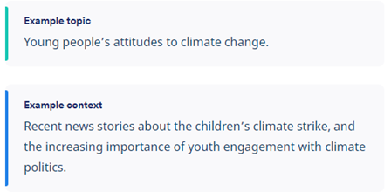
!
How to Write a Dissertation Introduction?
?
Topic and context: it enables the reader to understand your dissertation.
!
!

Slide 7
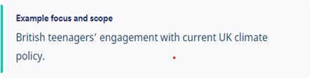
!
How to Write a Dissertation Introduction?
?
Focus and scope: It addresses the explicit feature of your dissertation topic.
!
!

Slide 8
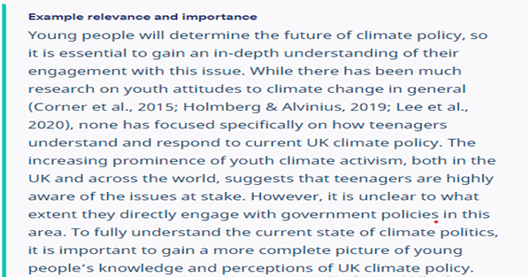
!
How to Write a Dissertation Introduction?
Relevance and importance: It shows the reader how you fit in the current work of the topic.
?
!
!

Slide 9
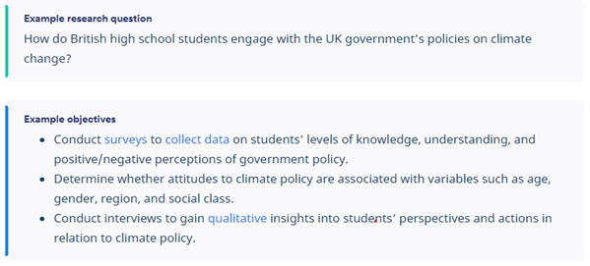
!
How to Write a Dissertation Introduction?
?
Questions and objectives: It shows what dissertation intents to determine and how.
!
!

Slide 10
!
How to Write a Dissertation Introduction?
?
Relevance and importance: It shows the reader how you fit in the current work of the topic.
!
!

Slide 11
!
How to Write a Dissertation Introduction?
?
Overview of the structure: It explains the overall aim of each chapter of dissertation.
!
!

Slide 12
!
?
GOOD LUCK
!
!

