Slide 1






!
Conceptual Framework
(If Quantitative)
?
!
!

Slide 2
!
What is Conceptual Framework?
?
A conceptual framework exhibits in research of what is expected to attain through out the research.
It explains the variables which are used in the research and it maps out in how these variables are relatable to each other.
!
!

Slide 3
!
What is Conceptual Framework?
?
The core reason of a conceptual framework under research are to present the authors synthesis of the literature review and how to elucidate the concept so that the person reading may understand it clearly.
!
!

Slide 4
!
How To Construct A Conceptual Framework?
?
Constructing of the conceptual framework, includes many dimensions that are to considered by the author of the study.
A conceptual framework is a important visual tool that assists researcher to analyse and attain a comprehensive insights.
!
!

Slide 5
!
How To Construct A Conceptual Framework?
?
It is essential for researcher to select the topic for the research related to research. Conceptual Framework can be utilised in different contacts and variations, so it is beneficial in many areas of work, it is generally utilised to visually analyse the relationships, systems and ideas in an organised approach.
!
!

Slide 6
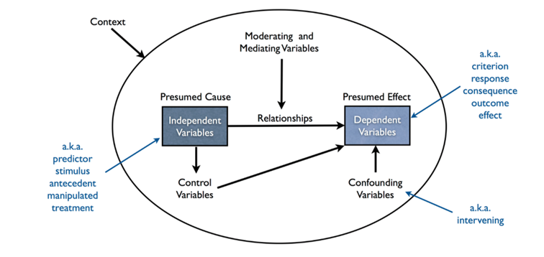
!
How To Construct A Conceptual Framework?
?
!
!

Slide 7
!
How To Construct A Conceptual Framework?
?
Variables: In research, the variables are defined as properties or characteristics that the researcher is incline to study.
Independent and Dependent Variable: The independent variable is the variable that the variable that is expected to be impacted by influence of dependent variable. Whereas, the dependent variable is what may happen as a result of independent variable.
!
!

Slide 8
!
How To Construct A Conceptual Framework?
?
Moderating Variables: It is a variable, the existence of which changes the original relationship in between dependent and variable relationship. In addition, the moderating variable leads under any study which decreases or increases influence that an independent variable have upon dependent variable.
!
!

Slide 9
!
How To Construct A Conceptual Framework?
?
Mediating Variables: It helps to explain the relationship in between the two variables. Moreover, it explains the correlation held in between the two or more variables.
Control Variables: In research, the control variable is that variable that is held constant in the study. In addition, these variables are such that they support the independent variables.
!
!

Slide 10
!
What Is The Structure Of The Conceptual Framework?
?
The conceptual framework tends to be generative frameworks which reflect the thinking of the whole research procedure
Selection of the Topic: The researcher of the study needs to make sure that the topic selected for the research needs to be within the area of specialisation.
!
!

Slide 11
!
What Is The Structure Of The Conceptual Framework?
?
Placing Literature Review: The author of the research needs to make sure he or she has carried out literature review via various sources. This is a important step, as major part of the research is depended upon it
!
!

Slide 12
!
What Is The Structure Of The Conceptual Framework?
Generating the Conceptual Framework: The researcher needs to develop a conceptual framework utilising mixture of different variables from the scientific articles which have been used for the study by the researcher for a particular subject matter. In addition, the conceptual framework is formed by making sure researcher takes into account the problem statement and/or research objectives when developing it.
?
!
!

Slide 13
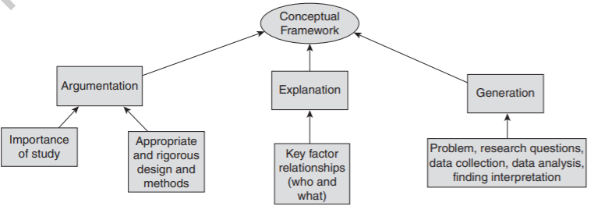
!
What Is The Structure Of The Conceptual Framework?
?
!
!

Slide 14
!
Difference Between Conceptual Framework & Theoretical Framework
?
In the context of thesis, there are some differences pertaining in between conceptual framework and theoretical framework.
When it comes to theoretical framework, it addresses a broader, wide or general set of ideas which are belonging to a research. On the other hand, conceptual framework is regarded to exhibit a narrow or specify ideas which a researcher utilises within his or her study.
.
!
!

Slide 15
!
Difference Between Conceptual Framework & Theoretical Framework
?
Under theoretical framework is relied on existing theories or theory formed by expert in the past which had been validated and tested by other research scholars. Whereas, the conceptual framework is based upon the concept which includes the major variables under a study.
.
!
!

Slide 16
!
Difference Between Conceptual Framework & Theoretical Framework
?
Theoretical framework is carried out as a kind of theory which pivots the research with exponents the studies.
Whilst, when it comes to conceptual framework the researcher makes sure to explain the relationship that prevails among major variables in the research study
!
!

Slide 17
!
Difference Between Conceptual Framework & Theoretical Framework
?
Theoretical framework, pertains the theories which are interrelated with the proposal mentioned.
On the other hand, conceptual framework pertains of the concepts that are interconnected to evaluate the relationships among them and in which ways the author of the study asserts to answer towards the research problem
!
!

Slide 18
!
?
GOOD LUCK
!
!

