Slide 1






!
List Of Abbreviations In
The Dissertation
?
!
!

Slide 2
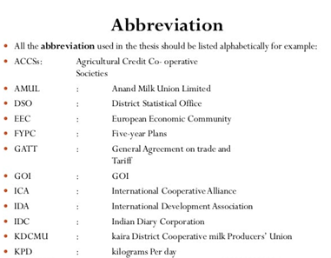
!
What are Abbreviations and Acronyms?
Figure 1 List of Abbreviations
?
Abbreviation is simply a reduced form of a term.
In dissertation, abbreviations are handy as you need to embrace loads of writing in a small space.
For example (e.g.) Corp. for Corporation.
!
!

Slide 3
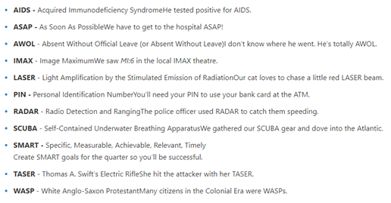
!
What are Abbreviations and Acronyms?
Figure 2 List of Acronyms
While, when talking about acronyms, it consists of the initial letters of a phrase which generally forms another term.
For e.g. RADAR for Radio Detection and Ranging, or SMART for Specific, Measurable, Achievable, Relevant, Timely.
?
!
!

Slide 4
!
List Of Abbreviations In A Thesis Or Dissertation
If your dissertation comprises of several abbreviations, then there is a definite need to provide all the abbreviations in an alphabetical list along with their meanings or definitions.
It improves your readability and insights about the document.
Making a list of abbreviations does not only make you to have a better insight about the document, but it also improve the course of your designation, as it frequently and repeatedly avoids to explain the abbreviations in your main writing or text.
?
!
!

Slide 5
!
Where Do You Put The List Of Abbreviations?
In any case if you have used only few abbreviations, then there is no need to add a separate list to your designation.
You can just follow the directions given below to have a better idea on how to explain the abbreviations in between a text.
?
!
!

Slide 6
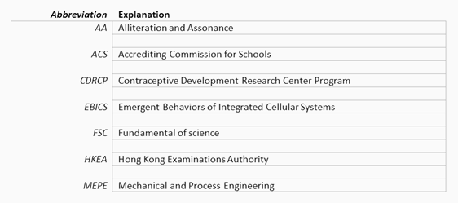
!
Where Do You Put The List Of Abbreviations?
?
Figure 3: List of Abbreviations in Between Text
!
!

Slide 7

!
Rules for Using Acronyms and Abbreviations
?
Figure 4: List of Abbreviations in Between Text
!
!

Slide 8
!
Rules For Using Acronyms & Abbreviations
When using acronyms and abbreviations there are some certain rules that needed to be kept in mind.
When you are using acronyms or abbreviations first time in your designation, it is considered a good and healthy practice to write a full phrase or terminology along with the acronym or abbreviation (within a parentheses).
?
!
!

Slide 9
!
Rules For Using Acronyms & Abbreviations
After that, there is no longer a need to use the full terminology again, you can then use the acronym or abbreviation in the whole dissertation. For e.g.:
‘It would create countless range of opportunities for the local developers of Information Communication Technology (ICT), if they utilise the ICT in the agriculture sector.’
?
!
!

Slide 10
!
Rules For Using Acronyms & Abbreviations
?
However, there are some exceptions to this rule which are very common acronyms which substitutes the terms that you use in your daily life, such as NASA, IT, UK etc.
But, it is better to use full form of phrase to clear out any doubt.
!
!

Slide 11
!
Example Of Abbreviated List For A Dissertations Or Thesis
?
The following table deliberates the importance of numerous acronyms and abbreviation utilised throughout the dissertation.
The page number is also given in which the acronym or abbreviation is firstly used or defined.
!
!

Slide 12
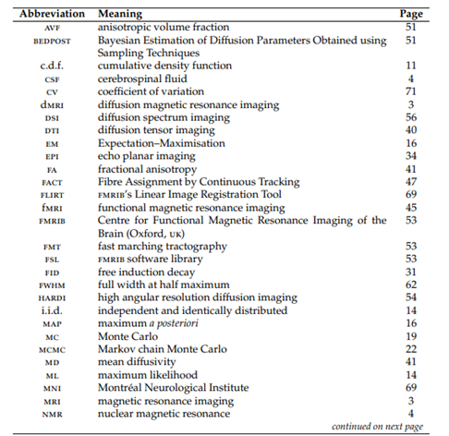
!
Example Of Abbreviated List For A Dissertations Or Thesis
?
Figure 5:
List of Abbreviations &
Acronyms in a Dissertation
!
!

Slide 13
!
Abbreviations In APA
Whenever you are using American Psychological Association (APA), there are some common practices that is necessary to follow.
Whenever you are abbreviating a phrase, you should write the full terminology when you use it the first time, and it should be followed instantly by the abbreviation within the parentheses (as discussed above).
?
!
!

Slide 14
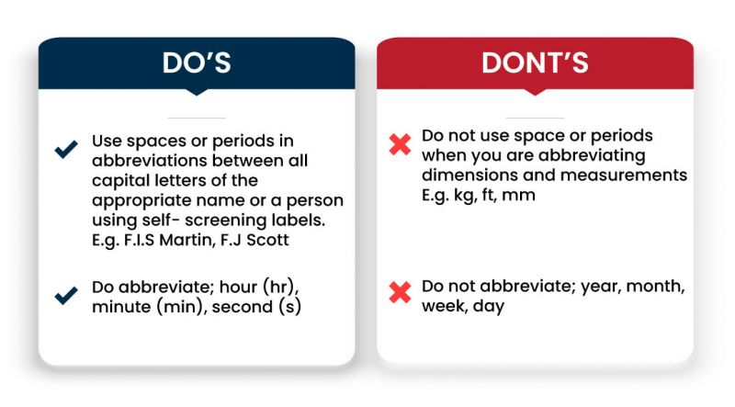
!
?
!
!

Slide 15
!
Checklist
Heading of “LIST OF ABBREVIATIONS” should all be in capital letters and you should centre it 1” underneath the top of page.
You should include a double- space line between the first entry and the heading.
You should arrange the abbreviations in an alphabetical manner.
Your abbreviations needs to be aligned with the left margin of dissertation or should be indented by means of consistent tabs to the right side of left margin.
?
!
!

Slide 16
!
Checklist
If any entry or abbreviation takes the space of more than one line, then you need to add single- space between two lines.
Between each entry, you need to add a double- spaced line.
The page(s) of LIST OF ABBREVIATIONS needs to be numbered with consecutive Roman figures (lower case) and centred with margin ½” above from bottom edge.
?
!
!

Slide 17
!
?
GOOD LUCK
!
!

