Slide 1






!
?
Research Aim & Objectives
!
!

Slide 2
!
What Are Research Aims & Objectives?
?
The aim of your research needs to be precise and expressed in a way that it should be easy to find out when it has been accomplished.
While, the objectives plans certain stages that you will require to accomplish you aim of research.
Objectives explains that WH questions of your research.
!
!

Slide 3
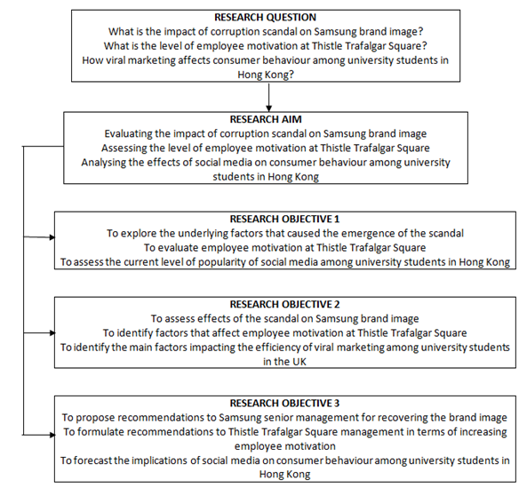
!
?
!
!

Slide 4
!
Importance Of Aims & Objectives In Research
Aim and objectives are an important part of a dissertation.
Aims are the understanding and awareness that your require to resolve your research question.
While, objectives are certain actions of your research which you propose to perform in your project of research.
?
!
!

Slide 5
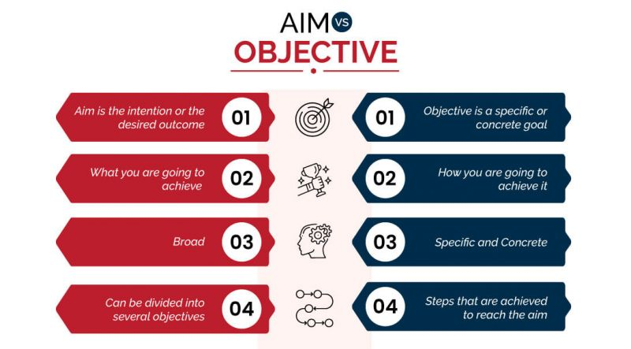
Major Difference Between Aims & Objectives
!
?
!
!

Slide 6
!
How to Write Research Aims & Objectives?
There is no defined structure in writing aim and objectives of research.
Every researcher will have a slightly different approach in writing it.
However, there are few simple ethics that you need to follow for
virtuous practice, such as; Your research aim needs to answer the questions given below;
Why is this study necessary?
What is this study all about?
How do you intend to do it?
?
!
!

Slide 7
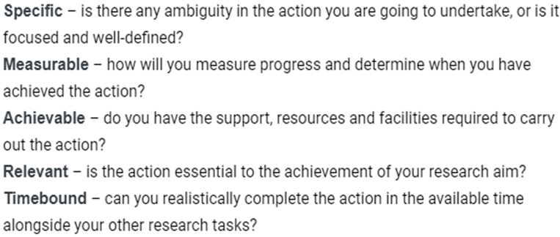
!
How to Write Research Aims & Objectives?
While, each objective of your research needs to be SMART
(Specific, Measurable, Achievable, Relevant, Timebound)
?
!
!

Slide 8
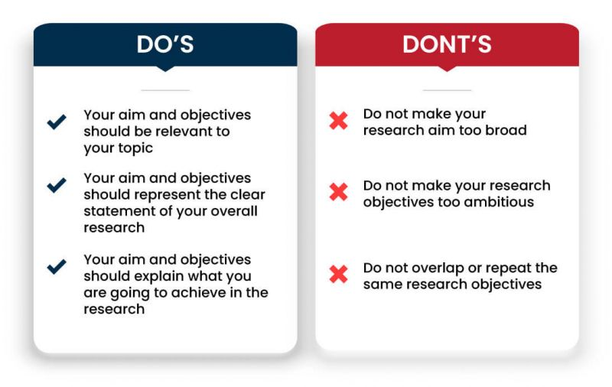
!
?
!
!

Slide 9
!
?
GOOD LUCK
!
!

