Slide 1






!
Dissertation Structure- Table Of Contents
?
!
!

Slide 2
!
Briefing About Table Of Contents
?
The list of table of contents is usually present on the initial page before the start of the dissertation or any other written work.
The table of contents or TOC comprises of names of the chapter or titles of the sections or headings, or brief descriptions with the page numbers they are commencing on.
!
!

Slide 3
!
Briefing About Table Of Contents
?
By adding an organized list of Table of Content, the reader will immediately be able to distinguish that in what way your manuscript has been constructed or organized and would then further then skip down to chapters that would be most relevant or appealing to them.
A representable TOC is an initial pointer towards a good research paper.
!
!

Slide 4
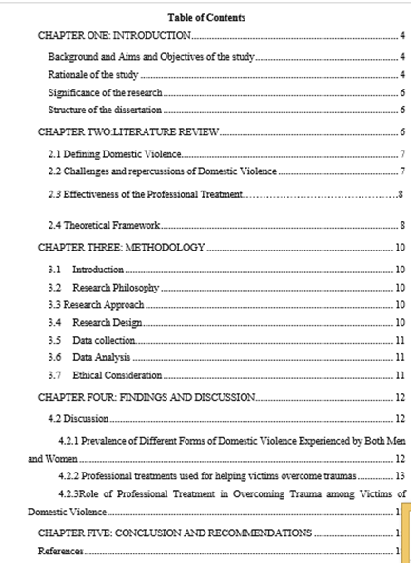
!
?
Example Of A Table Of Contents
!
!

Slide 5
!
What To Include In Your Table Of Contents
A good table of content is always the one that comprises of clear and concise headings. In context to a research proposal or dissertation, a table of content consists of main chapter headings that are usually a part of a research study.
The easiest way to include nicely formatted table of content is to change all of the main headings to ‘Heading 1’ in a Word document. The subsections of all these headings would be turned into ‘Heading 2’
?
!
!

Slide 6
!
What To Include In Your Table Of Contents
There is a certain procedure to apply a Table of Content or TOC in this way.
Click on References from the first tab, followed by table of contents, and then customized table of contents and by making sure that the levels of the Table of Contents are listed more than 3
?
!
!

Slide 7
!
What Not To Include
?
It is true that a good table of content is the one that contains of all details of chapter headings and their sub headings.
There are certain headings that need to be kept in mind when designing a table of content.
!
!

Slide 8
!
What Not To Include
One of the rule of academic writing is to refrain adding abstract and acknowledgments in the list of table of contents that need to be kept in mind when designing a table of content.
The most prominent reason for this is since, the information or data that is added in these two headings are of fewer relevancies to the research topic.
?
!
!

Slide 9
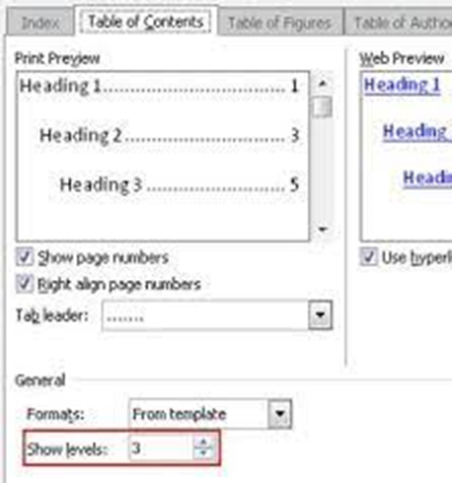
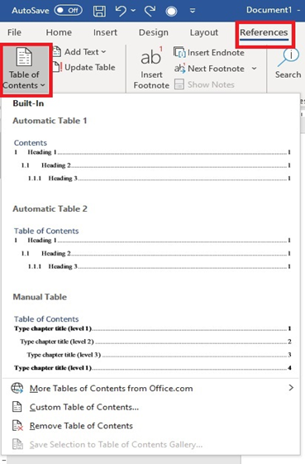
!
Appendices And Tables
?
!
!

Slide 10
!
Checklist
A good table of content is the one that is nicely and appropriately formatted
It comprises of all main sections of the manuscript commencing with the dedication page. However, in cases where the dedication page is not utilised, it is suggested to start with an Abstract page.
?
!
!

Slide 11
!
Checklist
The execution of a good table of content comprises of lists with the titles of each of the chapter, in addition all the main headings should be Heading Level 1.
All the titles and headings that are a part of the table of content should go exactly with what appear in the text.
Implementation of correct page numbers on all page numbers.
?
!
!

Slide 12
!
?
GOOD LUCK
!
!

