Slide 1






!
?
Types Of Literature Review
!
!

Slide 2
!
Definition Of A Literature Review
A literature review is referred to as a piece of academic writing which explicit knowledge and understanding of the academic literature based on particular topic that requires to be in context. It is generally an overview of major writings and other sources that are based on the topics selected. The sources that are used in writing literature review includes scholarly journal articles, books, online websites and government reports. It provides a description, summary and assessment of each source.
?
!
!

Slide 3
!
Types of Literature Reviews
?
Systematic Review
Theoretical Review
Methodological Review
Argumentative Review
Integrative Review
Historical Review
Critical Review
Scoping Review
Conceptual Review
Narrative (Traditional) Review
!
!

Slide 4
!
Systematic Review
?
This form of the literature review comprises of an overview of present indication that is relevant to a clearly articulated research question, that utilises pre-stated and standardised tools for the identification that is critically evaluated study in order to gather, report and examine information from the literatures that are involved in the appraisal. It therefore, emphasis on precise experiential question that is frequently posed in the cause-and-effect form.
!
!

Slide 5
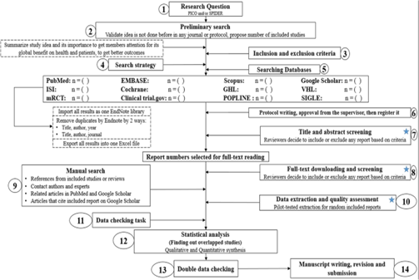
!
Systematic Review
?
!
!

Slide 6
!
Theoretical Review
?
This review is the form that concretely examines the amount of concept that has accrued in this regard to a problem, notion, model and phenomena. The theoretical review aids in forming what theories already exist and identifies the relationship between them. The focus of the analysis would be on theoretical concept or the entire theory or framework.
!
!

Slide 7
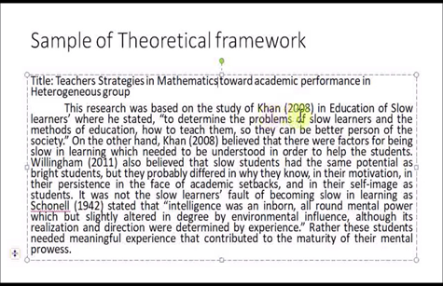
!
Theoretical Review
?
!
!

Slide 8
!
Methodological Review
An appraisal does not always emphasis on what is said by someone and how it is said. However, this methodological review provides a framework that possess towards comprehending the framework at different levels. It therefore, enables the investigator to draw on extensive assortment of knowledge that ranges from theoretical level to applied documents. It ensures to have a structure to the literature.
?
!
!

Slide 9
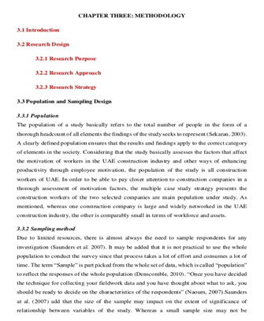
!
Methodological Review
?
!
!

Slide 10
!
Argumentative Review
This type of the literature review assesses the literature selectively for supporting and disproving a dispute where deeply entrenched assumptions, philosophical problem has already been recognised in the literature. The objective is to generate a body of literature which begins with a contrarian point of view. The argumentative methods help in assessing the study that helps in genuine and important form of discourse.
?
!
!

Slide 11
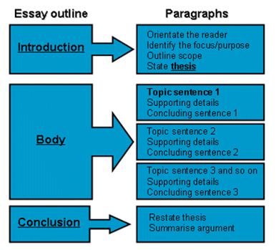
!
Argumentative Review
?
!
!

Slide 12
!
Integrative Review
?
It is the type of review that possess towards reviewing, appraising and producing demonstrative literature which is based on a topic in an integrated way where novel frameworks and perspectives are generated. The literature body involves all studies that are addressing to the identical hypotheses.
!
!

Slide 13
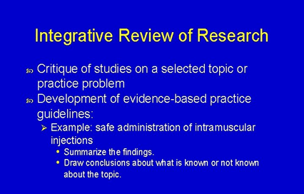
!
Integrative Review
?
!
!

Slide 14
!
Historical Review
It mainly focuses on assessing research throughout a period of time that often initiates with issue concept, theory, phenomena that is evolved in the literature and tends towards the development within the allowance of discipline. The main motive is to place study in historical context in order to illustrate knowledge with state-of-art growths and for the identifications for future research.
?
!
!

Slide 15
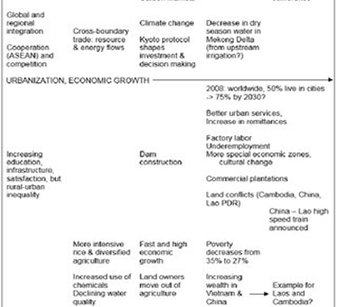
!
Historical Review
?
!
!

Slide 16
!
Critical Review
?
It is the type of review that emphasis more on detailed evaluation of the literature for comparing and examining various perspectives.
!
!

Slide 17
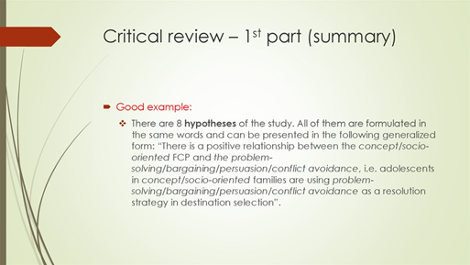
!
Critical Review
?
!
!

Slide 18
!
Scoping Review
?
This review is generally utilised at the starting of the research proposal. It is often conducted before the research is started and sets the stage for the research by highlighting the gaps in the research along with defining the needs for the research that is required to be carried out.
!
!

Slide 19
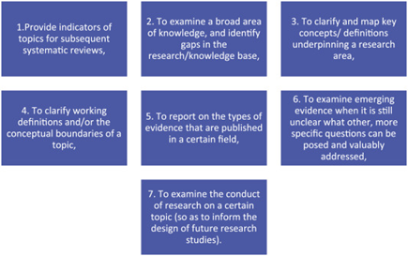
!
Scoping Review
?
!
!

Slide 20
!
Conceptual Review
?
The conceptual review is the one that rectifies the present understanding of the provided study topic. It explores how this knowledge was reaches and attempts to possess towards a greater understanding that is suggested. Thus, it gives a snapshot of that current situation of the particular field of research.
!
!

Slide 21
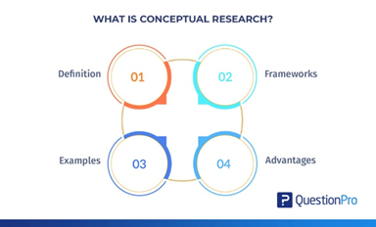
!
Conceptual Review
?
!
!

Slide 22
!
Narrative (Traditional) Review
?
It is one of the traditional review that usually appears as a chapter or an individual section in the thesis. It explains what related studies are already been carried out and how it informs the thesis along with determining how this dissertation fits into the research of particular field.
!
!

Slide 23
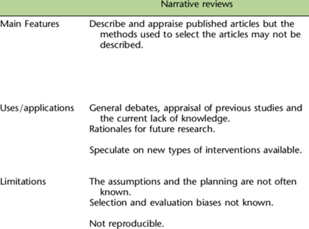
!
Narrative (Traditional) Review
?
!
!

Slide 24
!
?
GOOD LUCK
!
!

