Slide 1






!
How To Write Dissertation Abstract
?
!
!

Slide 2
!
What Is An Abstract?
The summary of research study at the start of dissertation/paper is called an “abstract”.
Abstract details about objectives, methods, and results of the study.
An abstract is usually between 150-250 words.
Abstracts should be written after the final draft of dissertation has been composed.
?
!
!

Slide 3
!
Components Of An Abstract
Aims
Methods
Results
Conclusion
?
!
!

Slide 4
!
Aims
Aims establish the basic purpose of your research. This purpose could be a subjective (qualitative) one, or can be formed as formal objectives of your study.
When writing aims, you first include some social background of your research, and then state your exact objective, such that there is a clear link between the problem and the solution your research offers.
?
!
!

Slide 5
!
Methods
After aims, you ,must elaborate exact methods applied in the research
Methods Should Include:
Research Philosophy
Research Approach
Design & Experiment
?
!
!

Slide 6
!
Methods
This section is usually written in past tense.
For example,
✔ This study used SPSS statistical tool to analyse data
✖ This study will use SPSS statistical tool to analyse data
?
!
!

Slide 7
!
Results
Now, you should summarise research results in a manner which highlight the most important aspect of the outcomes
It should be in 1-3 lines, and must be high precise in showing relationships and impacts
?
!
!

Slide 8
!
Conclusion
The conclusion is the sum total of your research. Conclusion must be,
?
Sum total of your research
Include recommendations
Be succinct
!
!

Slide 9
!
Abstract
?
As a rule of thumb, you should write abstract in the very end of your thesis. This helps the author in identifying exactly which aspects are most important, and hence should be mentioned in the abstract
!
!

Slide 10
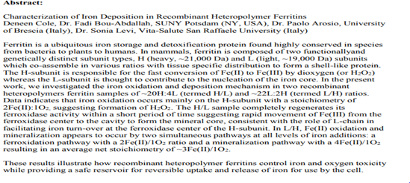
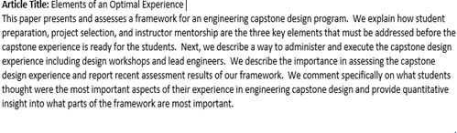
!
Abstract
A Good Abstract
A Bad Abstract
?
!
!

Slide 11
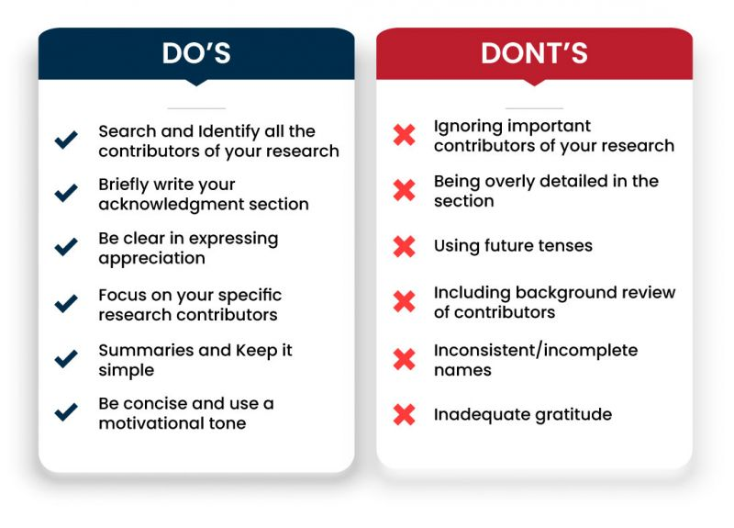
!
?
!
!

Slide 12
!
Checklist For Abstract Writing
Abstract is after the title page and acknowledgement, but before the table of contents.
The abstract is within the word limit of 150-250 words
Research problems have been clearly mentioned
Methodology have been succinctly elaborated
Summary of the results have been provided
Precise conclusion has been stated
Review for possible corrections and refinement of language
?
!
!

Slide 13
!
?
GOOD LUCK
!
!

